Slide 1
Guilford Fire Cadet Program
COME JOIN THE
GUILFORD VOLUNTEER FIRE DEPARTMENT
CADET
PROGRAM

Slide 2
Guilford Fire Cadet Program
The Guilford Fire Department’s Cadet Program is a hands on educational program for young men and women who are 14 (and have completed eighth grade) or 15 to 21 years old.

Slide 3
Guilford Fire Cadet Program
The Cadets purpose is to provide safe experiences that will help young people mature and to prepare them on becoming responsible and caring adults.

Slide 4
Guilford Fire Cadet Program
The fire department initiated the cadet program matching their people and resources to the interests of young people in the community. A strong emphasis is placed on teamwork, self – and mutual respect, and character as Cadets learn the basics of the fire department.

Slide 5
Benefits of Guilford Fire Cadet Program
Provide a valuable service to your community by providing your local fire department with help on Emergency and non-emergency tasks
Learn more about the fire and emergency services and what it’s really like to be a firefighter or EMT
Develop skills like leadership and teamwork
Spend time with other youth who have similar interests
Fulfill community service hour requirements for school and/or add leadership and volunteer experience to your college applications!

Slide 6
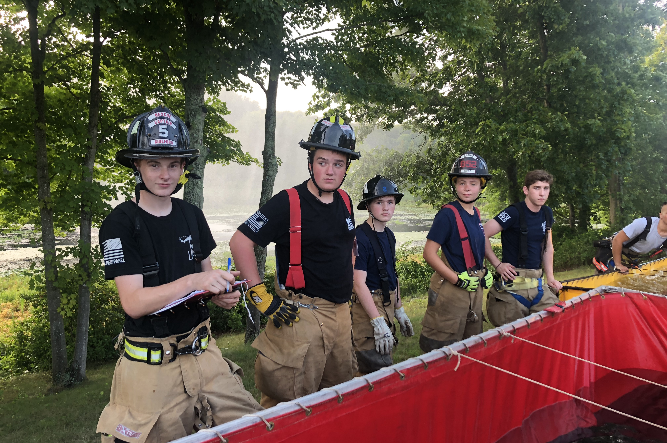
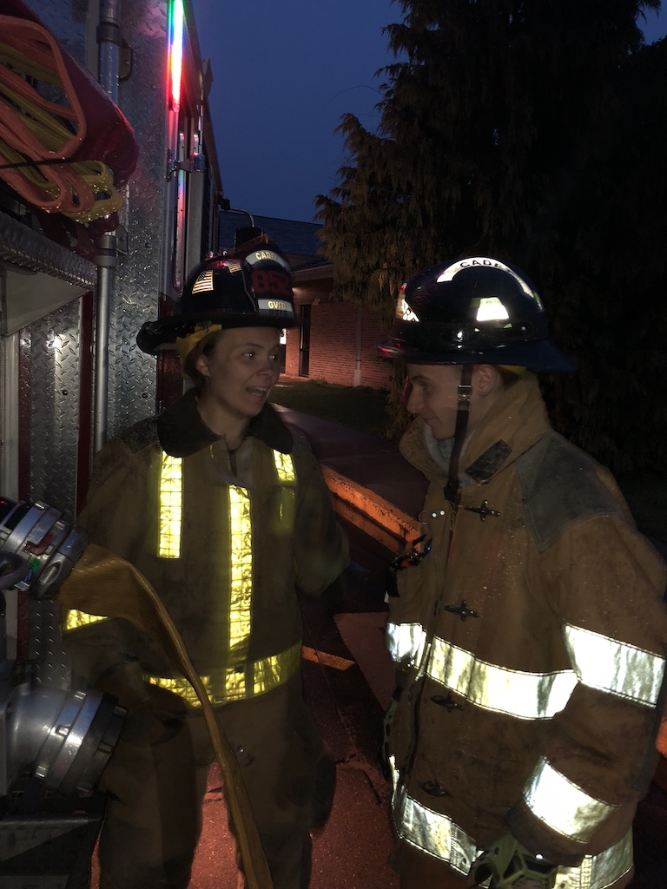
Benefits of the Guilford Fire Cadet Program
Provides career and personal skills in the Fire/Emergency Services
Participate in meaningful hands-on experiences that provide a safe, empowering and positive character based education
Prepares young adults for transition into the work force
Many inspired Cadets continue on to a fire and emergency services career
Creates a team building attitude
Greater community involvement
Scholarship opportunities
Among Many Others

Slide 7
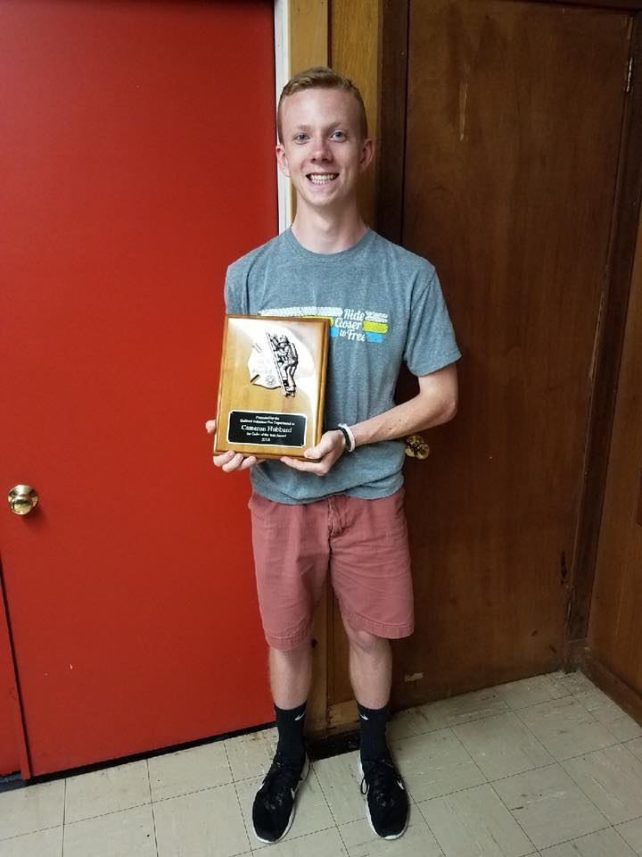
Events, Awards, and Membership
Guilford Cadet Program – Courses offered for cadet firefighters
Cadet Firefighter of the Year Award
Cadet Membership – Possible scholarship for schooling

Slide 8
Benefits of Guilford Fire Cadet Program
Career Opportunities
Develop relationships that may broaden employment options
Have an opportunity to become a Guilford Volunteer Firefighter
Service Learning
Encouraging the skill and desire to help others
Give back to the community
Leadership Experience
Develop leadership skills
Fulfill responsibilities in society
Exposure to different leadership traits
Life Skills
Develop physically & mentally
Become one of America’s bravest!
Character Education
Help make ethical choices
Fulfill responsibility to society

Slide 9
Communications and Outreach
www.nvfc.org/juniors
Find Us on Facebook (www.facebook.com/juniorfirefighters Follow Us on Twitter (www.twitter.com/nvfc)

Slide 10
Guilford Fire Cadet Program
Contact:
Guilford High School
Joel Rebhum
Dean of Students
rebhunjoel@guilfordschools.org
or
Guilford Volunteer Fire Department
203-453-8056
www.guilfordfire.com

